Slide 1
Paper Review of Jiwon Oh
Yongjun Choi
2025.09.22

Slide 2
Cellular lineage tracing by somatic variations for understanding human early embryogenesis
2020

Slide 3
1. Introduction
Somatic mutation -> Mosaicism (SNV, CNV, indel)
Can be used to understand early embryonic development
In this study,
Isolated single cell clones of different tissues from warm autopsy to elucidate cell lineage and cell fate.
Sequenced clones of single cells and identified somatic variants of each clone.
Conclusions
Found that asymmetric contribution of early two embryonic cells in adult tissue.
Found early embryo development is not coincide with the distance of adult tissue and the adjacent cell in embryo.
Showed cellular dynamics during gastrulation in wich ancestral progeny cells are enriched in certain anatomical locations.

Slide 4
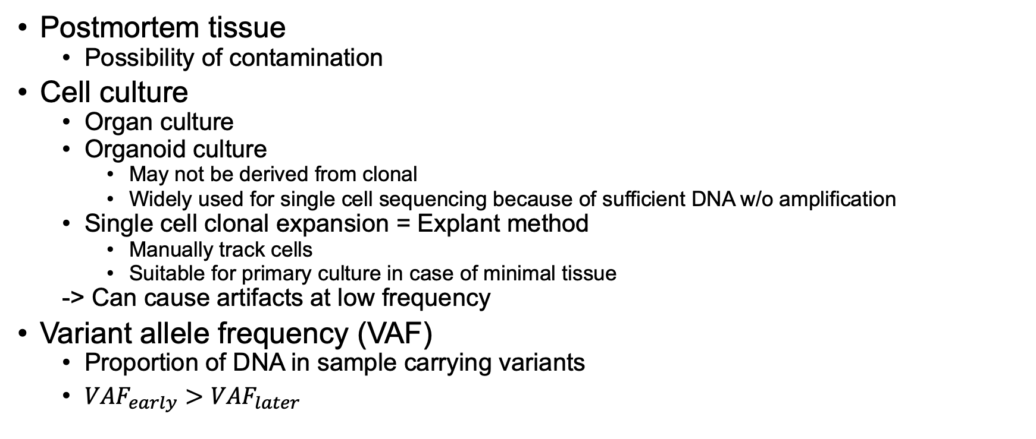
2. In vitro clonal expansion from postmortem tissue
Postmortem tissue
Possibility of contamination
Cell culture
Organ culture
Organoid culture
May not be derived from clonal
Widely used for single cell sequencing because of sufficient DNA w/o amplification
Single cell clonal expansion = Explant method
Manually track cells
Suitable for primary culture in case of minimal tissue
-> Can cause artifacts at low frequency
Variant allele frequency (VAF)
Proportion of DNA in sample carrying variants
$VAF_{early}>VAF_{later}$

Slide 5
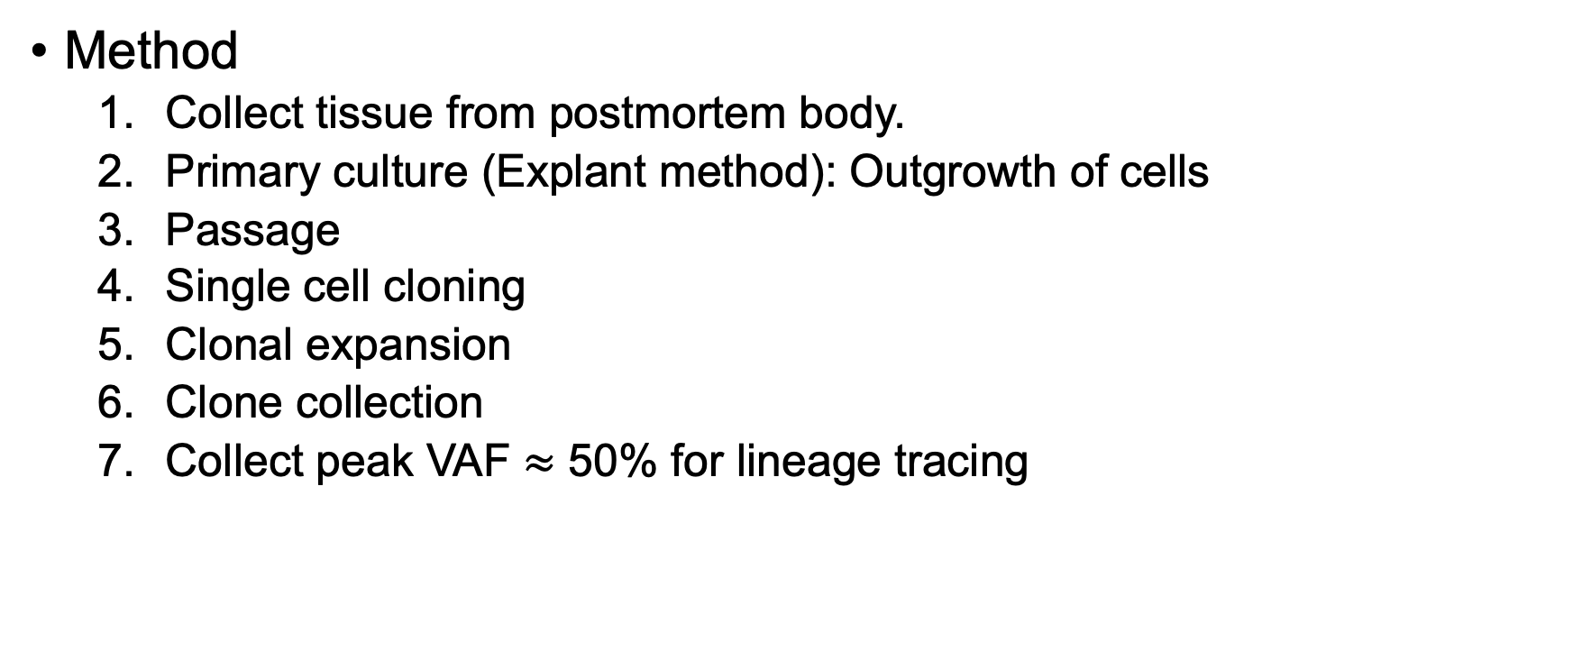
2. In vitro clonal expansion from postmortem tissue
Method
Collect tissue from postmortem body.
Primary culture (Explant method): Outgrowth of cells
Passage
Single cell cloning
Clonal expansion
Clone collection
Collect peak VAF $≈$ 50% for lineage tracing

Slide 6
3. Clonal dynamics in early human embryogenesis inferred from somatic mutation
‘Capture’ and ‘Recapture’
‘Capture’ [Phase 1]
Tissue collection -> Clonal expansion -> WGS -> Tree -> Mutation
‘Recapture’ [Phase 2]
Bulk tissues -> Deep sequencing of early mutation -> Analysis
Analysis
Early embryonic mutations from tree
Asymmetry and mutation rate in early embryogenesis
Data
Phylogenetic tree
Polytomy in internal node
VAF ratio matrix (Mutation x Colonies)
L1, L2 mutation group

